Slide 1
Jim’s Gym
CA Project

Slide 2
The Front End

Slide 3
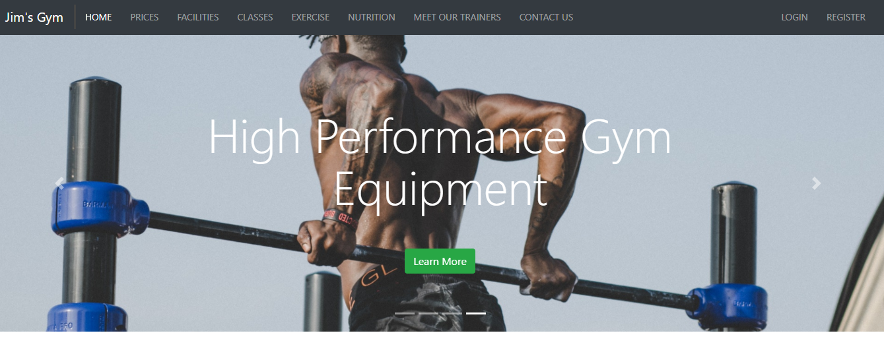
We used Bootstrap 4, this gave us a lot of flexibility
Homepage – little information design to grab your attention, and to encourage further exploration

Slide 4
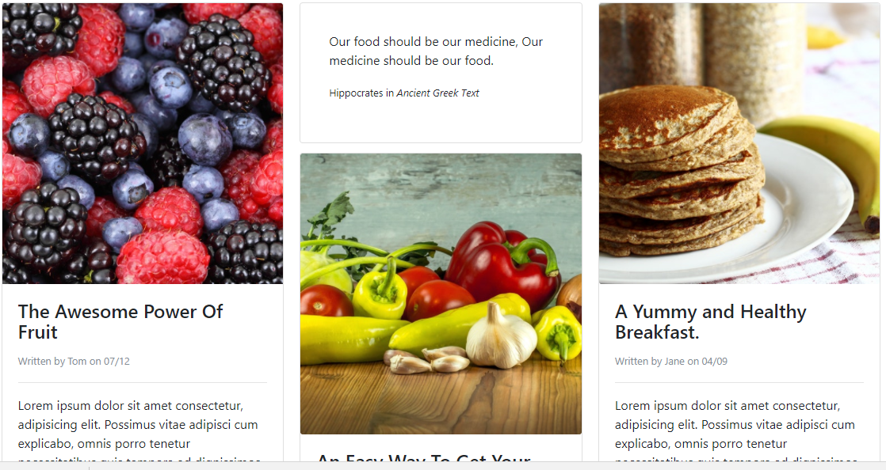

Slide 5
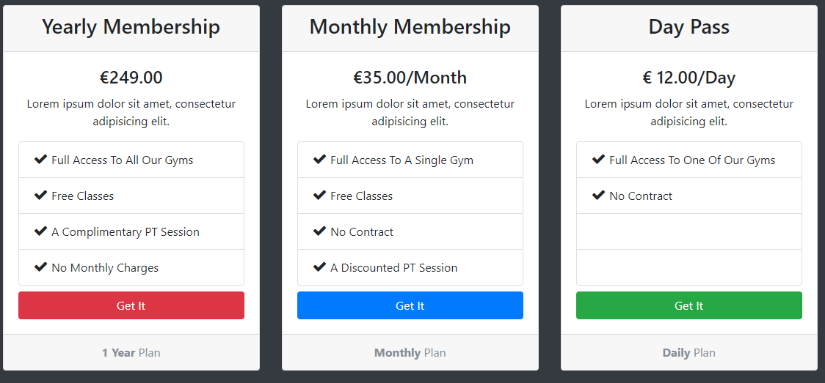

Slide 6
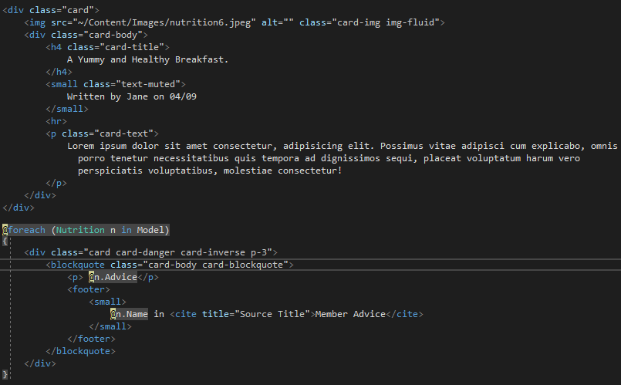

Slide 7
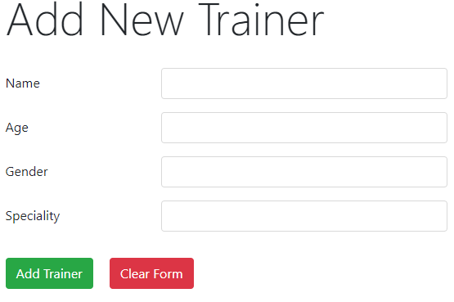
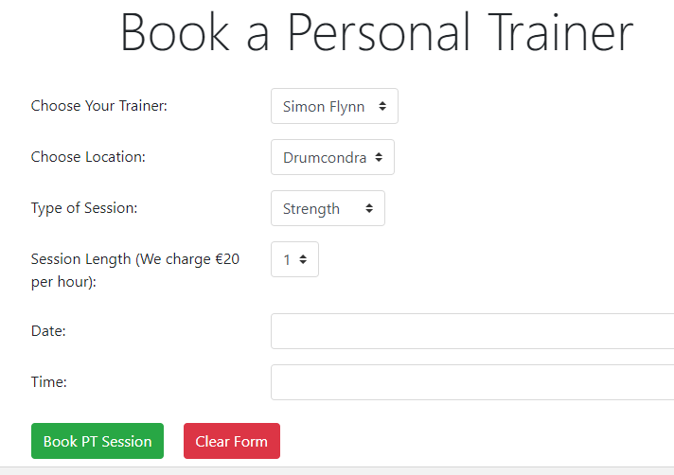

Slide 8
The Back End

